Slide 1
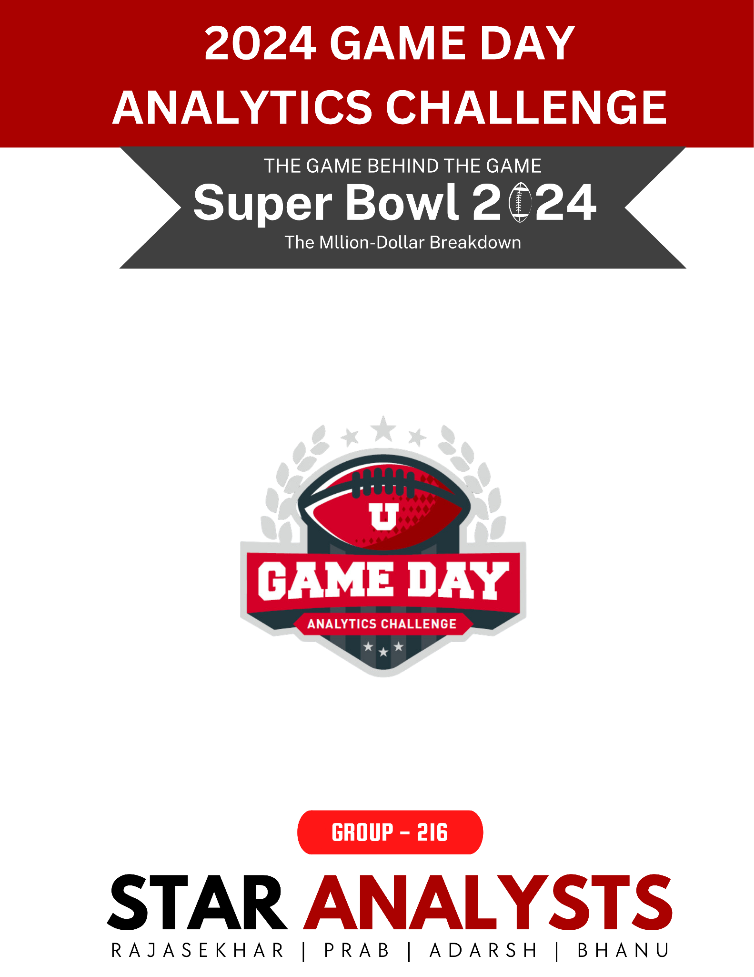
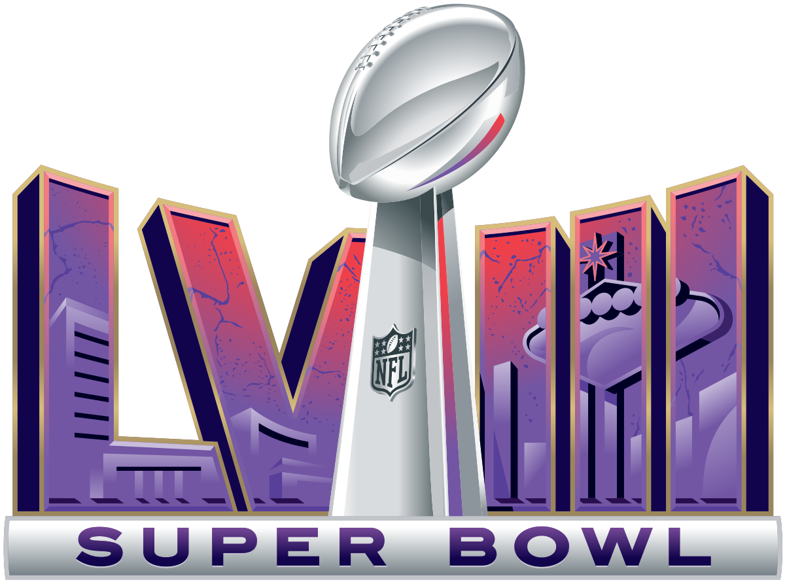

Slide 2
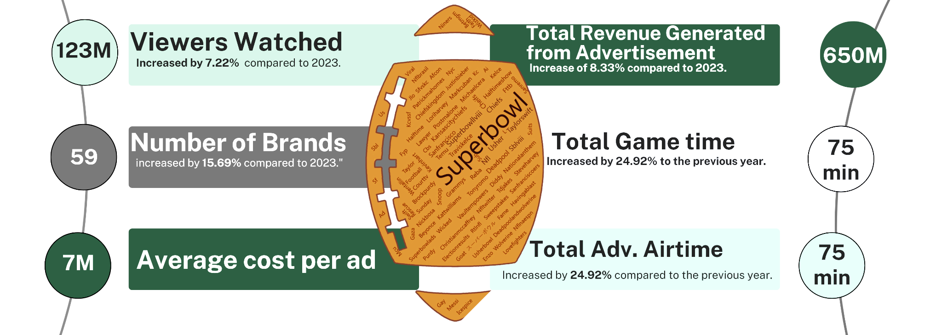
Super Facts

Slide 3
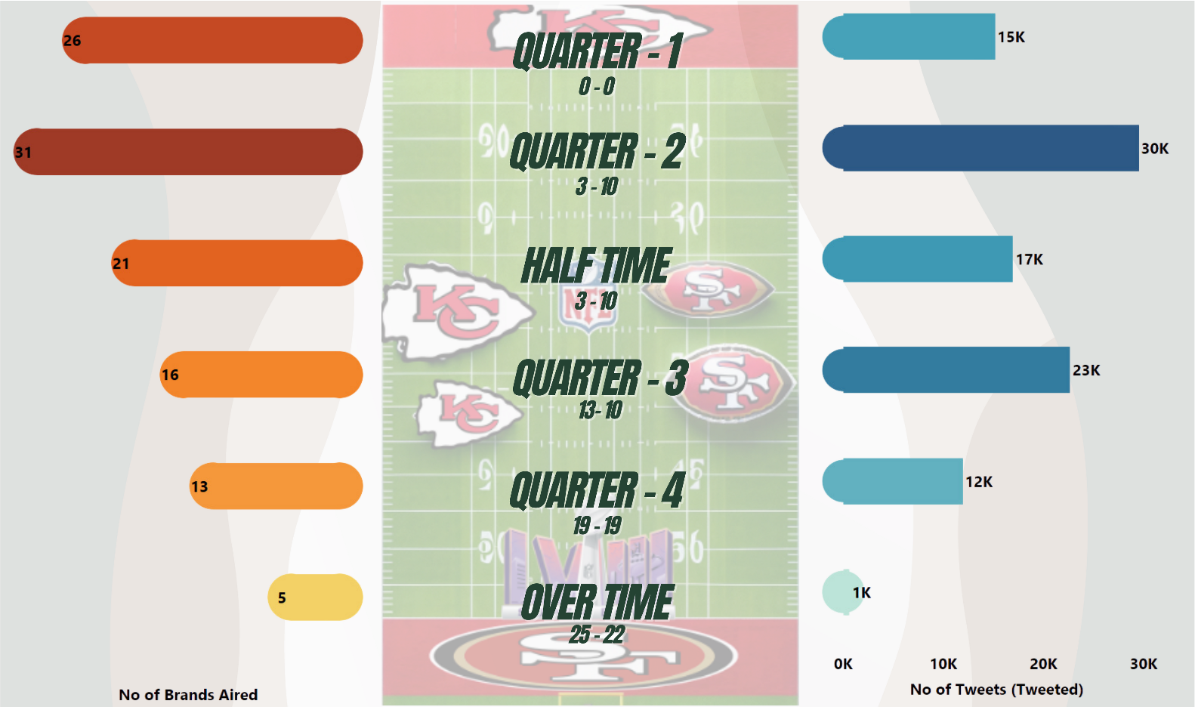
Quarter Analysis : Game of Ads and Posts

Slide 4
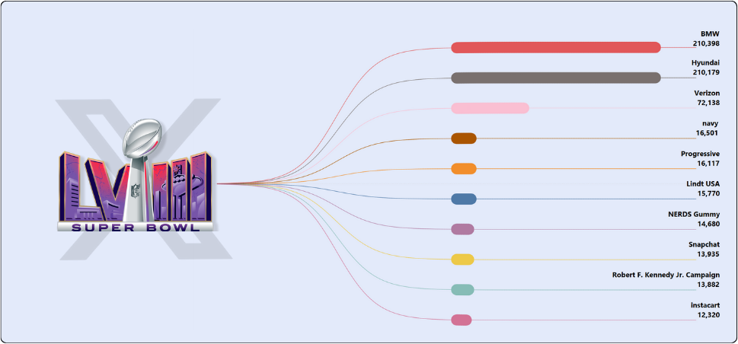
Top 10 Brands tweeted in 3 days

Slide 5
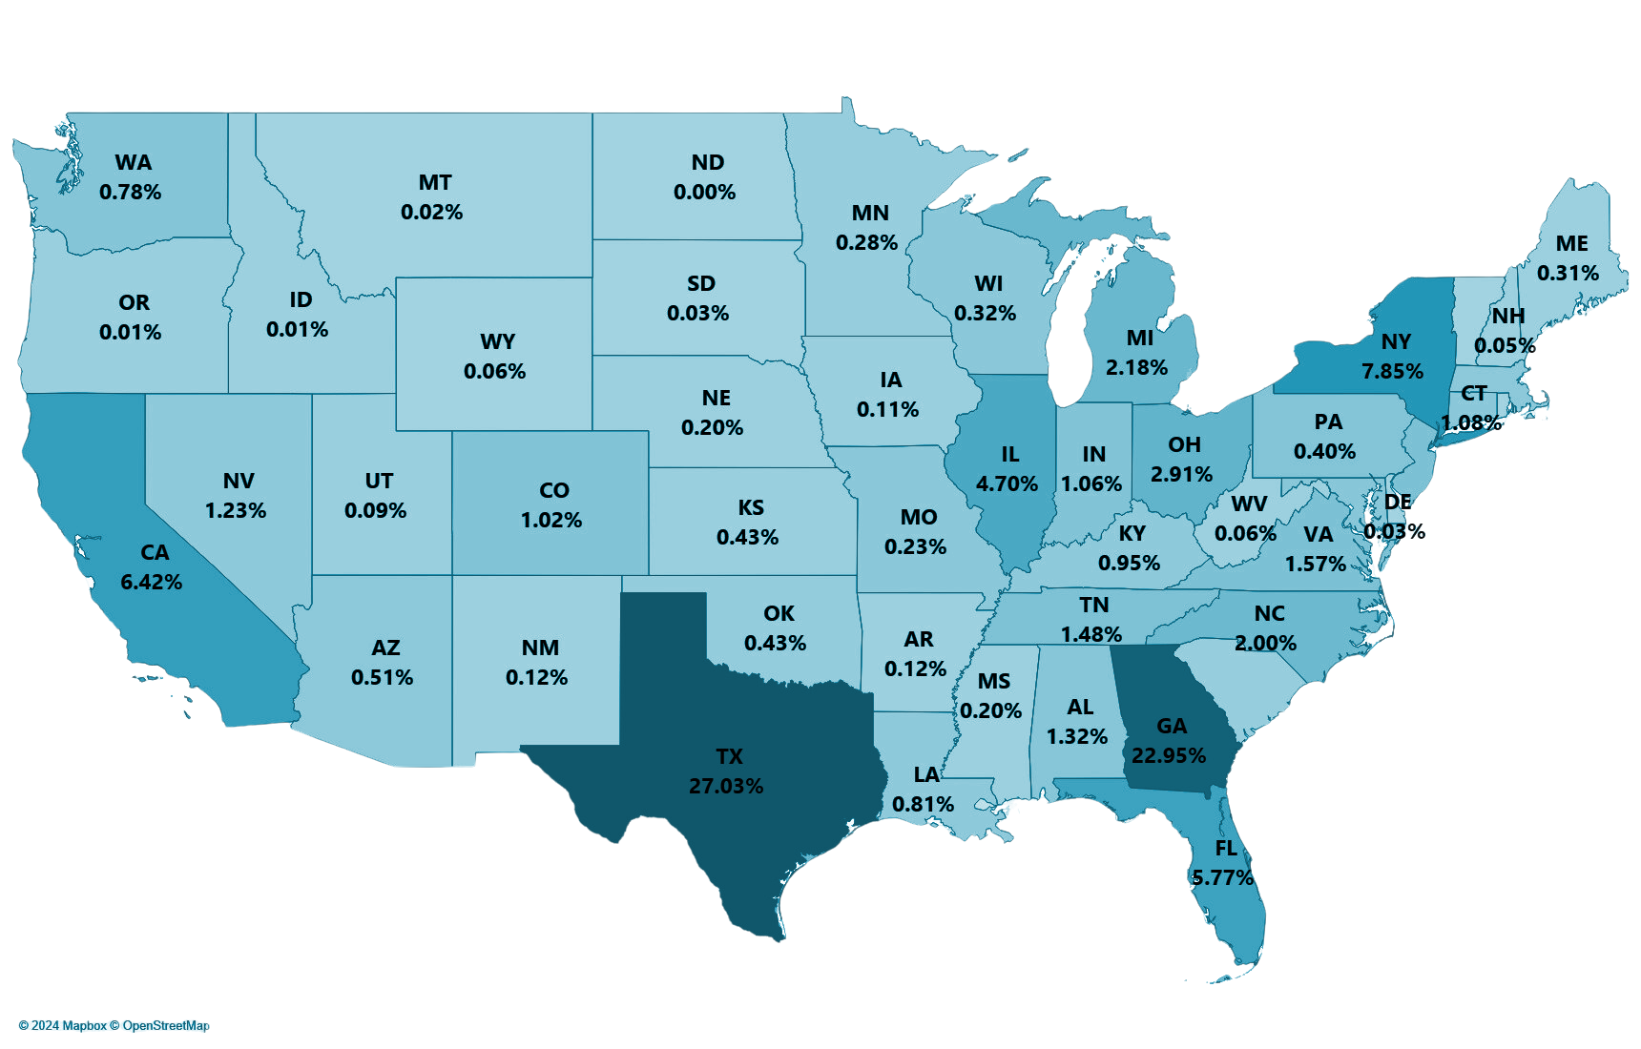
STATE OF TWEETS
⭐️ Star Studded, Skyscraper Sized and cowboy-tipping Super Bowl

Slide 6
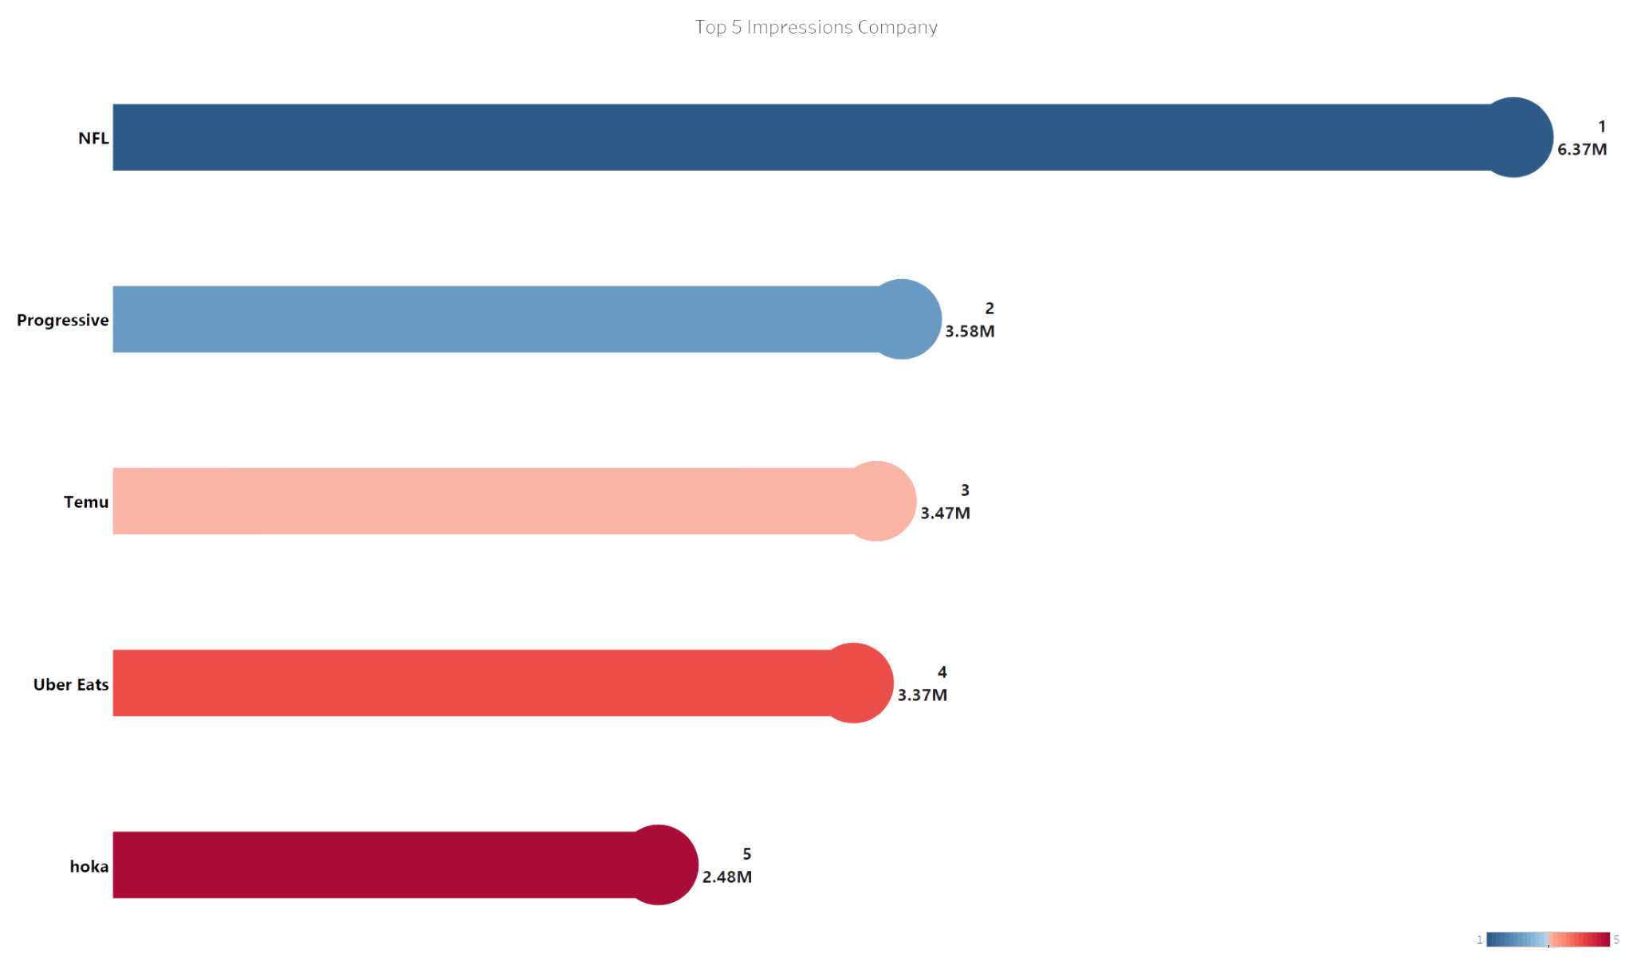
Impressive Enterprises

Slide 7
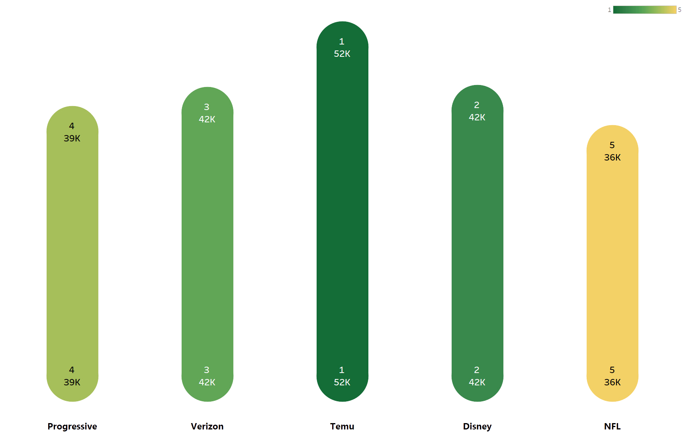
Companies Winning Hearts and Likes

Slide 8
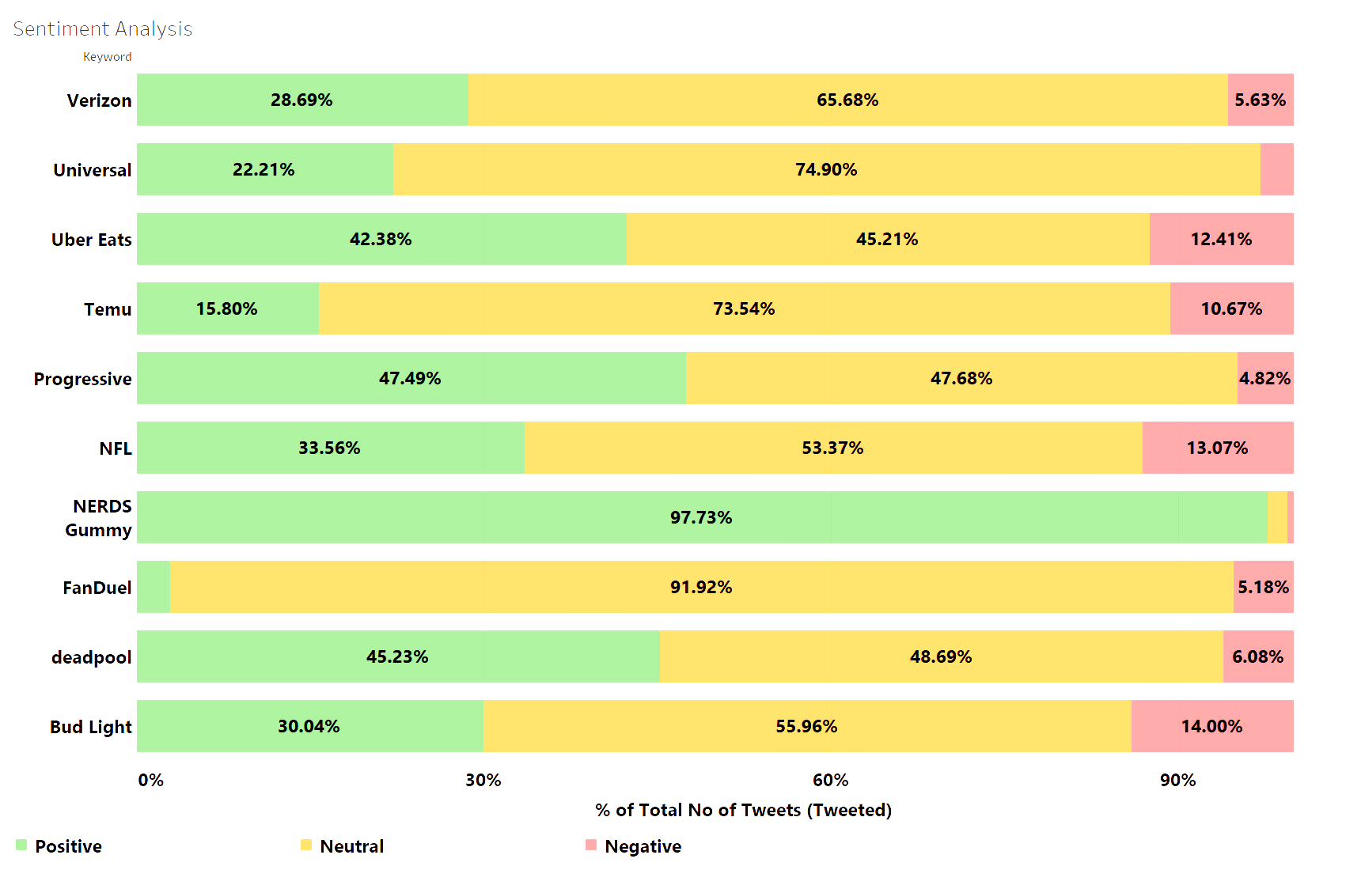
Sentiment Analysis

Slide 9
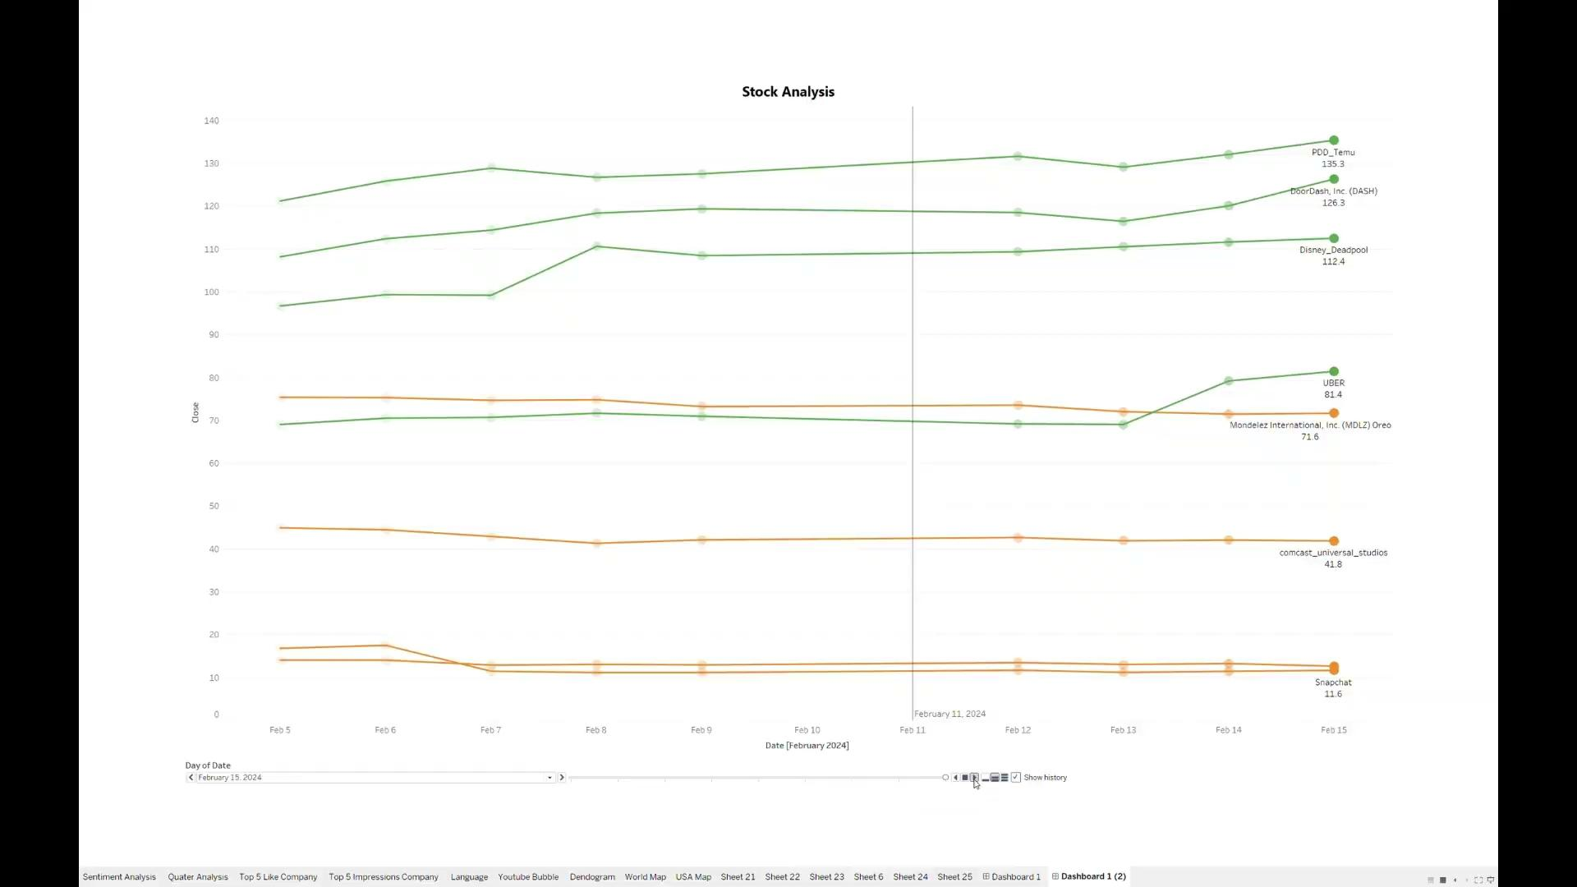
STOCK ANALYSIS

Slide 10
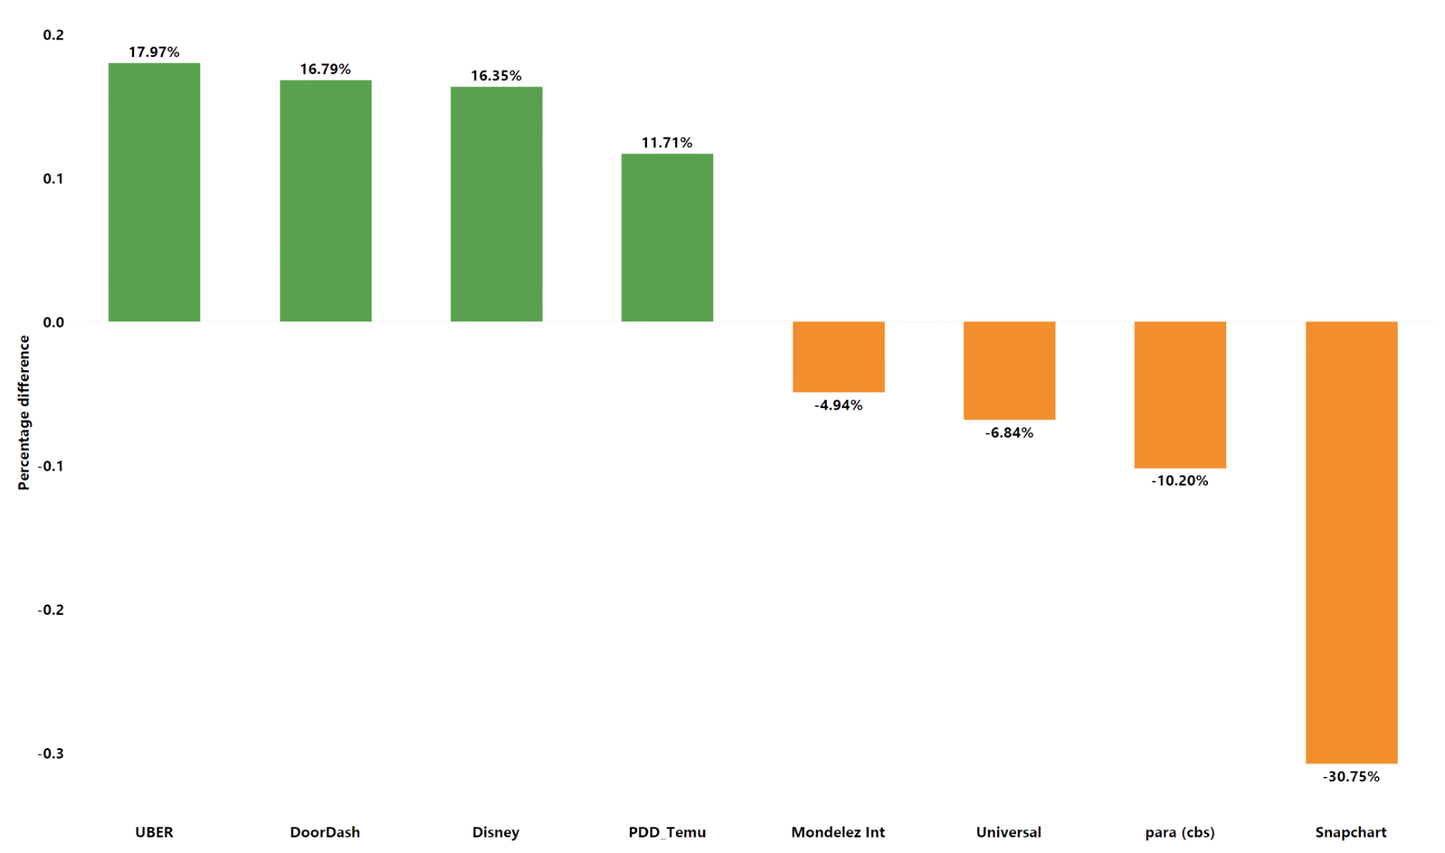
Stock Percentage Difference

Slide 11
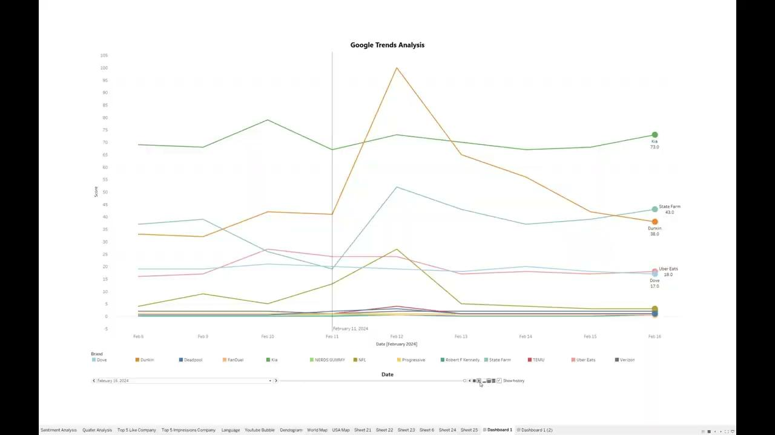
GOOGLE TRENDS

Slide 12
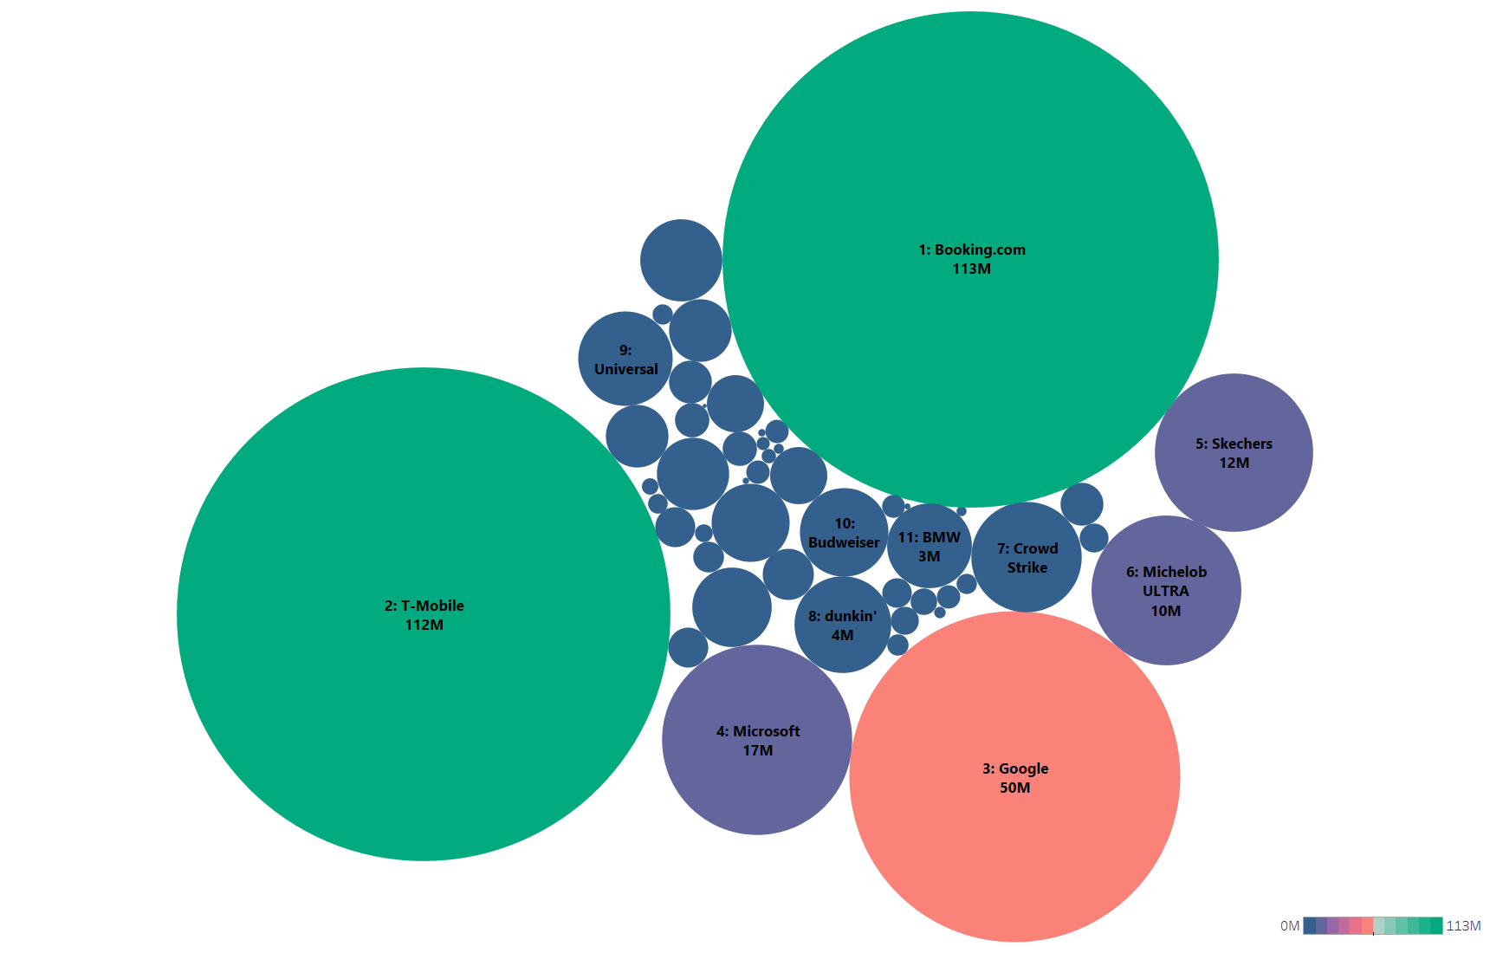



Youtube Views
01
02
03

Slide 13
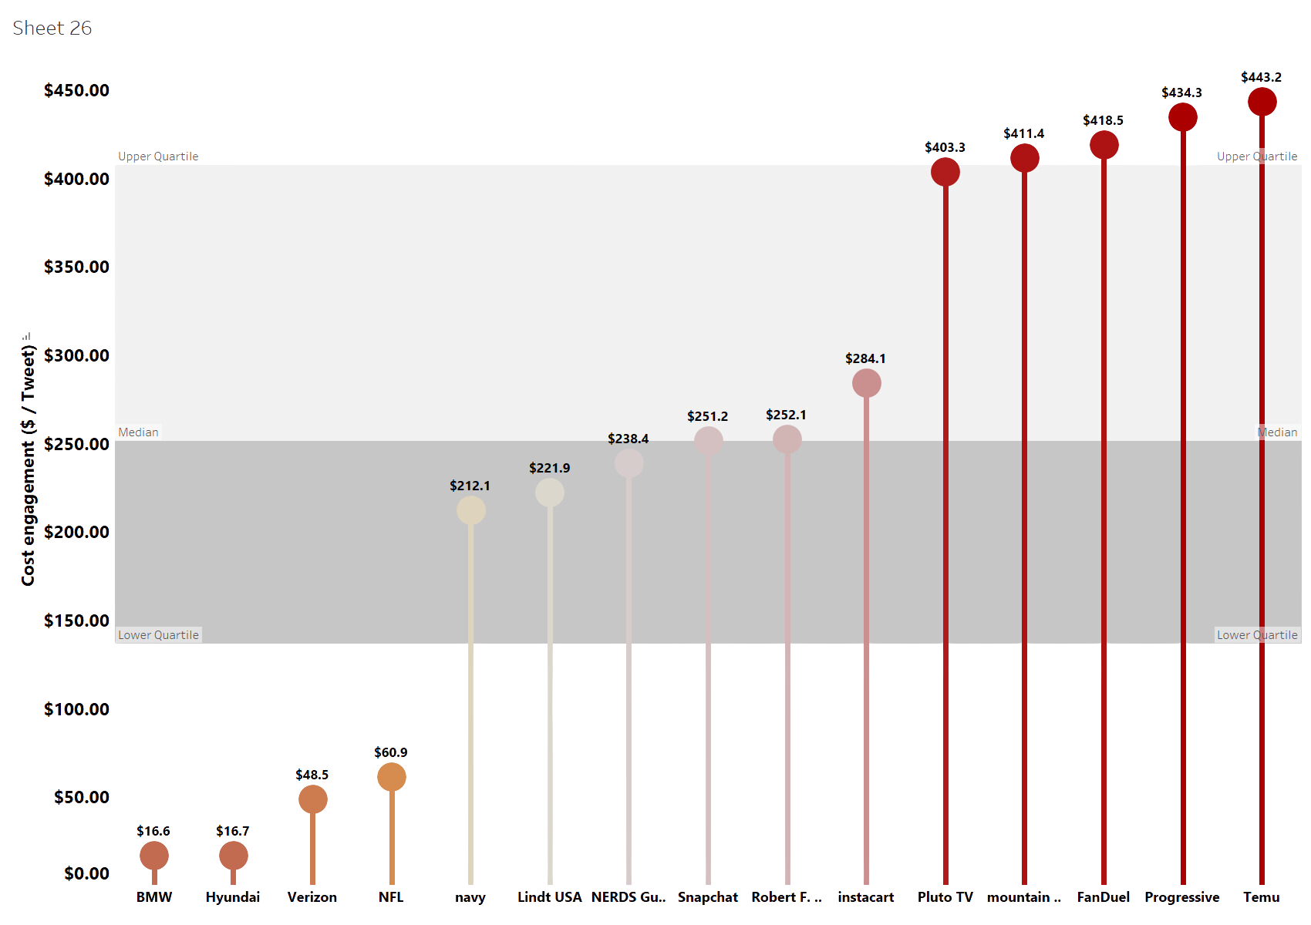
Cost Engagement

Slide 14
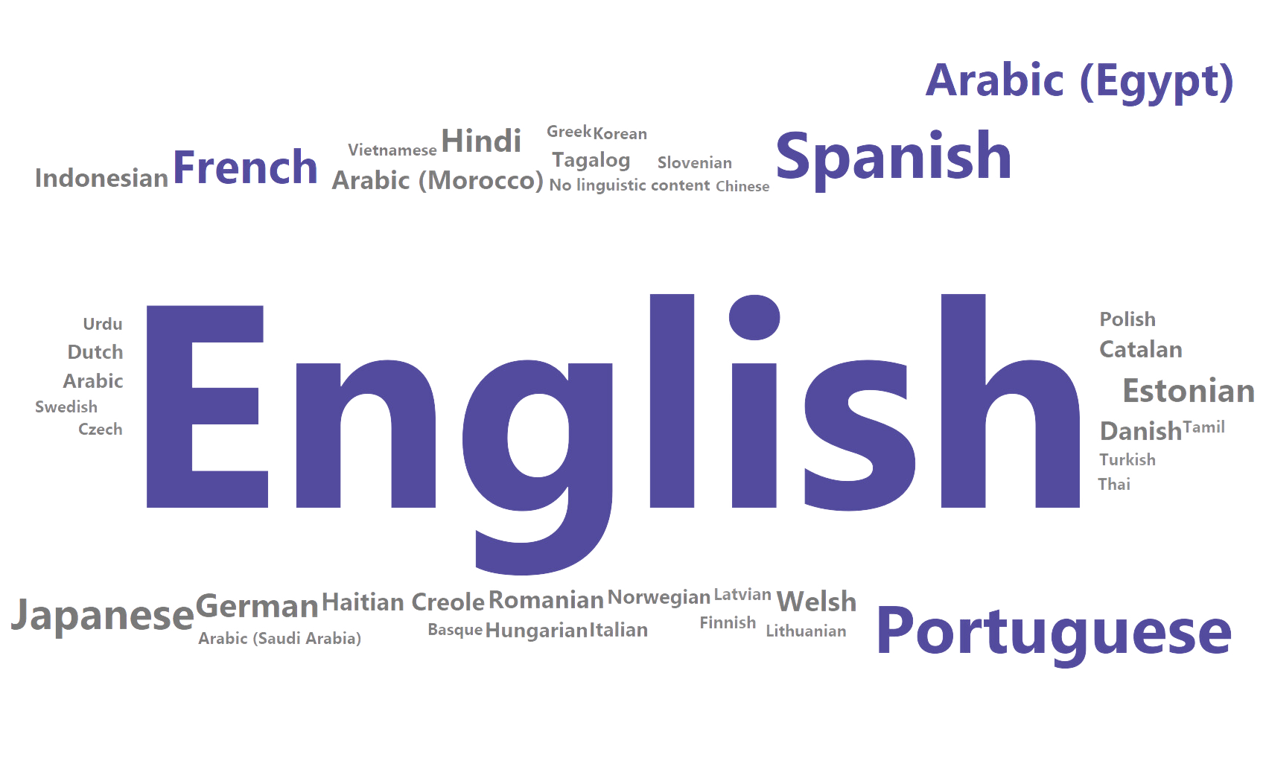
LANGUAGE LAB
Language Spectrum: Dive into the diversity of languages that shape our communication, with English at the core, surrounded by a rich tapestry of global tongues.

Slide 15
DID YOU KNOW?
- Google's touching story showcased tech's positive impact. Using AI, it spotlighted a visually impaired user and was directed by a blind filmmaker for emotive effect. - Dove's ad highlighted the 45% dropout rate among girls in youth sports. This marks their Super Bowl return after 18 years.

Slide 16
Thank You!
Do you have any questions?

